Slide 1
Classroom Procedures and Expectations
Mrs. Turner
Room 409
English/Language arts and
arkansas history/social studies

Slide 2
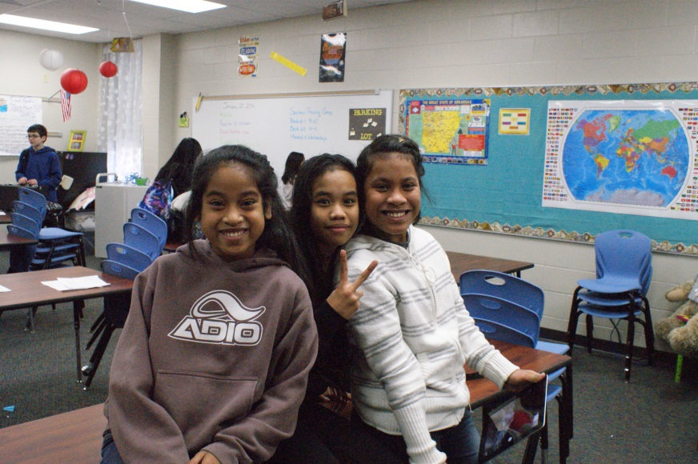
WELCOME
We’re going to have a wonderful (maravilloso) year together.
The following slides will introduce (introducir) our classroom procedures.
Having procedures will help us create an organized (organizar), safe (seguro), and positive (positivo) classroom.

Slide 3
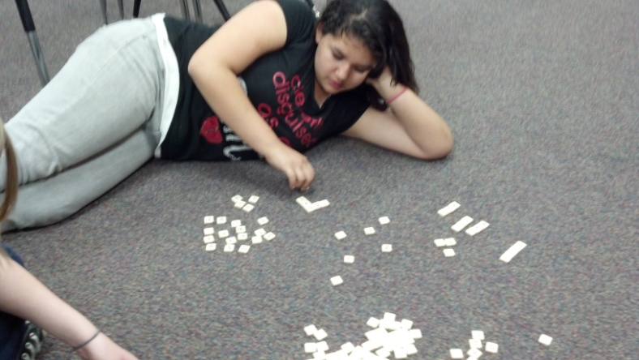
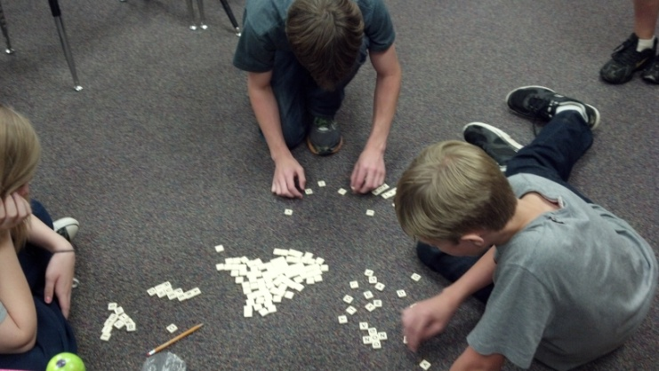
Why Procedures?
Procedures let us know what is expected of us.
Procedures help us to be efficient (eficiencia).
Everyone uses procedures to complete everyday tasks like cooking food, getting dressed, and playing a game.

Slide 4
Arrival to Class
When you enter the classroom please do so like ladies and gentlemen, and go to your assigned seat.
Prepare yourself for class by bringing all supplies needed, and pulling them out after you sit down.
If you do not have classroom supplies you are to let me know before class begins.

Slide 5
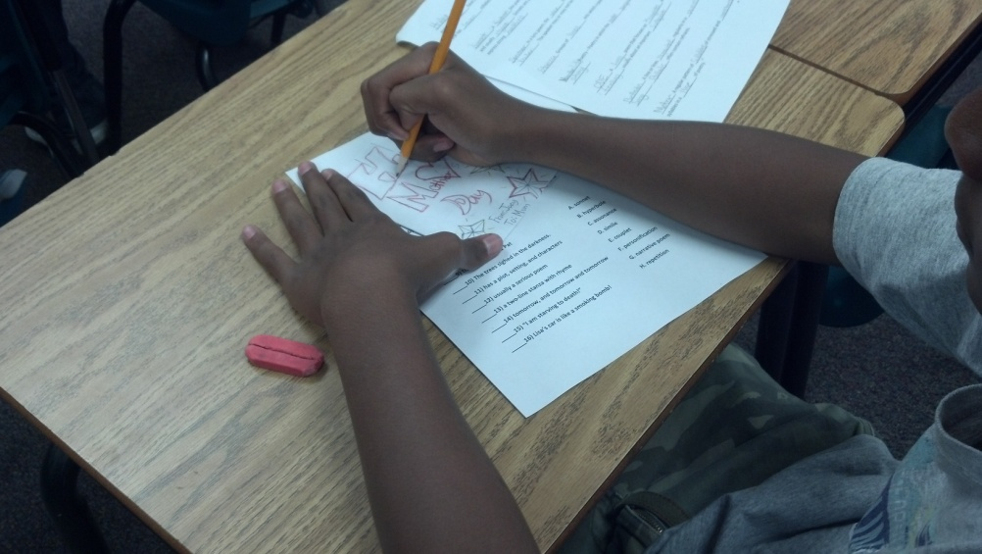
When Class Begins
You are to be in the classroom at 8:00 a.m. (10:00 am)
Class will begin with bellwork each day. Begin your bellwork shortly after entering the classroom.
There will be no talking or moving about the room during bellwork.
Please raise your hand if you need to speak with me.
Weekly assistants will be
responsible for bellwork and
the daily folder.

Slide 6
Journal Writing Procedures
Journals will be kept in Mrs. Turner’s classroom. No exceptions!
You will use them for taking notes, writing workshop, essay prompts, and more.
Write in pencil, or blue/black ink.
Follow the rules established for good writers.

Slide 7
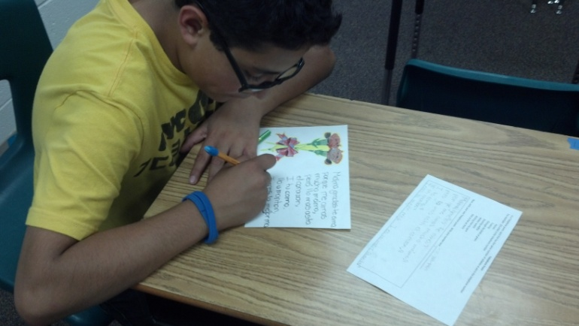
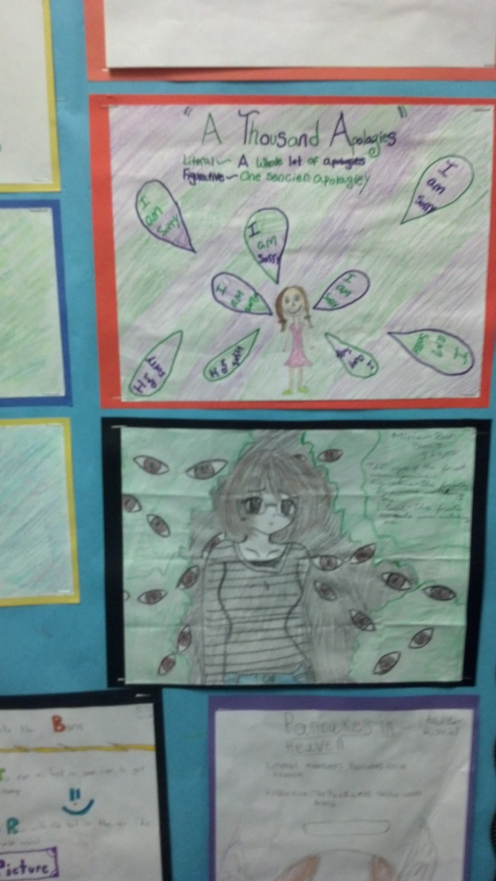
General Classroom Expectations
Follow directions quickly.
Raise your hand for permission to speak.
Raise your hand for permission to leave your seat.
Make good choices.
Make your dear teacher happy!
Work Hard…Be Nice!

Slide 8
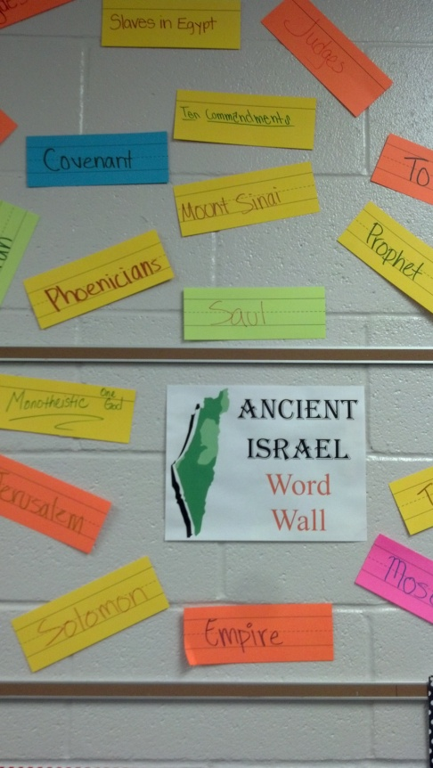
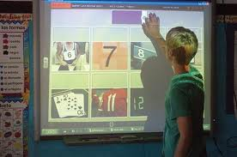
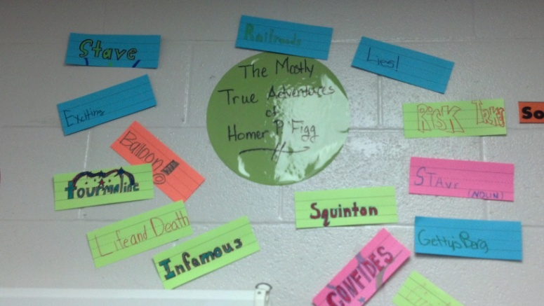
Expectations During Instruction
Please give me your full attention.
Do not start assignments until the I tell you to begin.
Only ask questions or make comments that are relevant to the lesson.

Slide 9
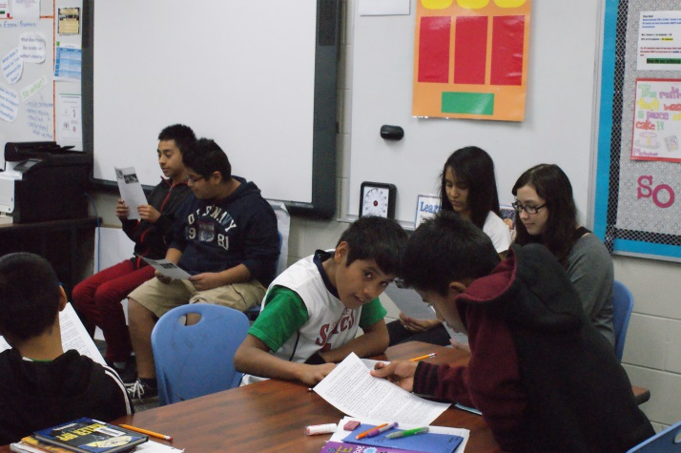
Expectations During Groupwork
You will be assigned to various groups during the year.
Within your team you will be assigned a jobs that you will be responsible for performing.
All team members must focus on the task at hand.
Students will create rubrics and grade team members on their contributions to the project.
If you are struggling with your teammates, please tell me.

Slide 10
Homework Expectations
You are to read 30 minutes every weekday on your own, outside of class. You will be required to record information about what you’ve read in a Reading Log. Reading Logs are to be completed, signed by a parent, and turned in each Friday. They are worth 100 points.
You will be required to read from a variety of genres and topics during the year. You will report on a book that you are reading each quarter. You will have a choice in how you present your work.
To practice or extend daily learning I will occasionally assign homework, beyond your nightly reading.

Slide 11
Attention Prompts
I will use three prompts in our classroom:
To get your undivided attention, I will say “class” and you will reply “yes.” You will respond in the same way I lead you. Let’s practice…
I will sometimes have you ‘teach’ each other by saying “teach” <clap> and you will respond by saying “ok” <clap>. Let’s practice…
If I need your attention, but it’s too noisy for you to hear me, or we’re somewhere I cannot speak – I will raise my hand and you are to raise your hand, look at me, and give me your undivided attention.
NO EXCEPTIONS

Slide 12
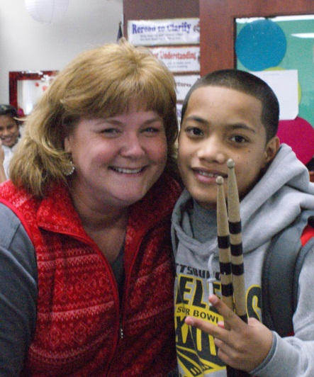
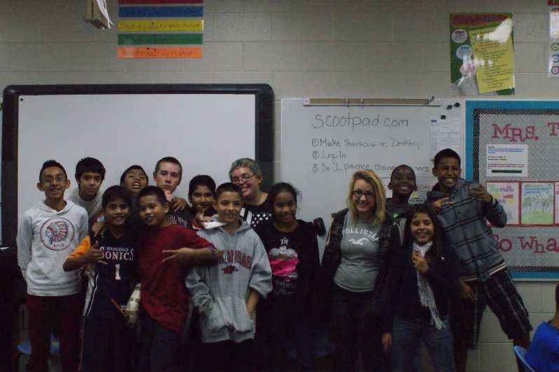
End of Class Dismissal
I will let you know when to gather your things and prepare to be dismissed.
I will dismiss you. You are not to leave the room until I do so.
Clean-up your work area and push your chair in before leaving. Last block will stack the chairs.

Slide 13
Behavior Discipline Procedures
1st Offense – Sign Agenda
2nd Offense – Sign Agenda, Conference with Mrs. T & classroom consequence (detention, student calls parent/guardian)
3rd Offense – Mrs. Turner contacts Parents/Guardians
4th Offense - Office Referral
Instant Office Referral for cussing, fighting,
stealing, bullying, vandalizing, or defiance.
Words and phrases you are NOT to use in our classroom:
“suck,” “my bad,” “IDK (or I don’t know),” “just saying,” or any type of bathroom language like “poop,” “fart,” “turd,” and “pee.” We will rehearse the proper way to communicate and not use slang terms in the classroom.

Slide 14
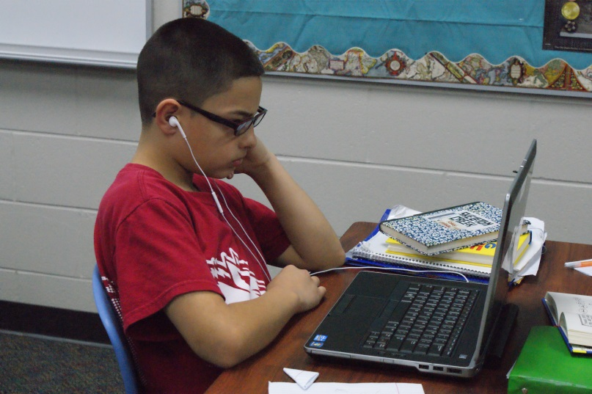
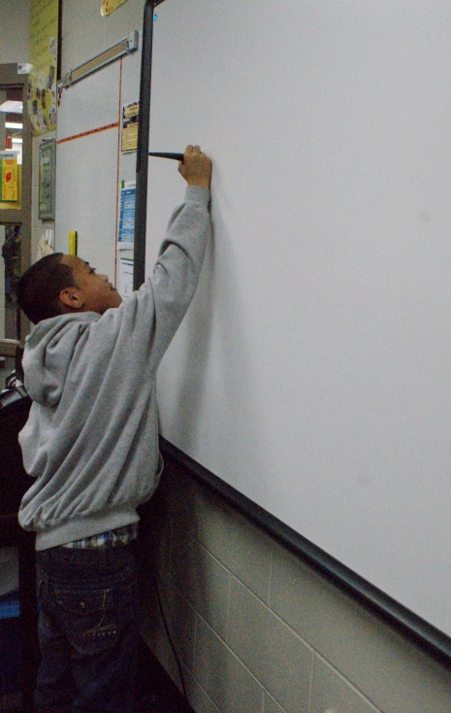
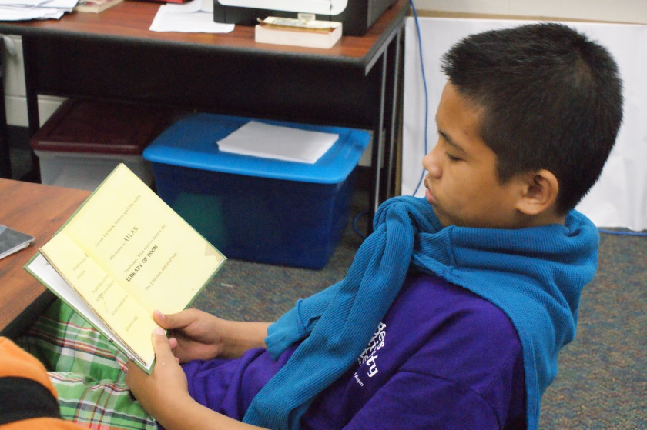
School Rules and Policies
All school rules as outlined in your student agenda will be enforced. Let’s go over the discipline policies.
The grading policy is defined in your agenda. Let’s go over them.

Slide 15
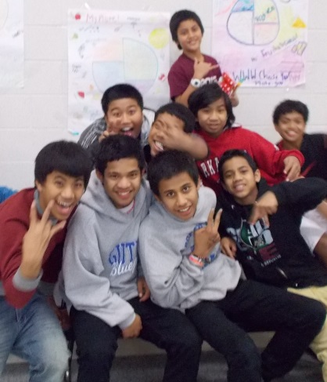
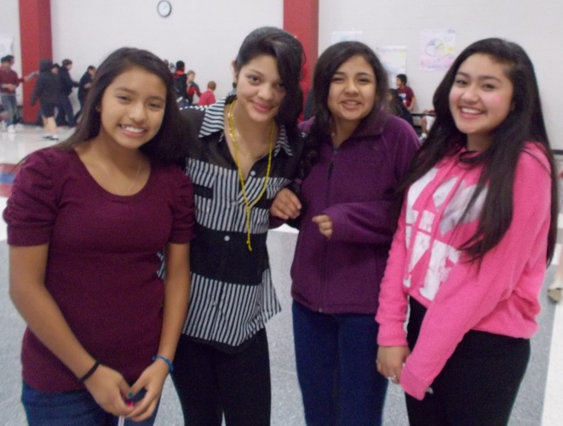
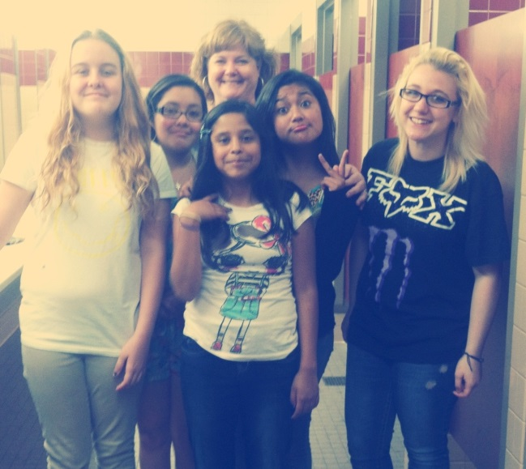
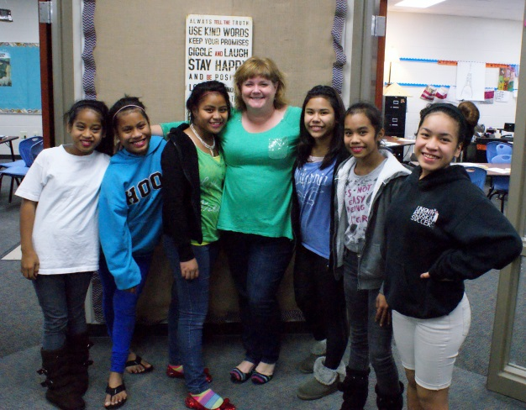
My Promise to You!
We will have a great year together.
Procedures and expectations will increase your learning experience.
I will give you my very best everyday and ask the same from you in return.

Slide 16
Mrs. T’s Motto

